Slide 1

CodeX Competion
By : Amal Amzath , Aaquib Kazi, Muskan Bhalla, Imthiyaz Najeeb
7A, JSSIS, Dubai.

Slide 2
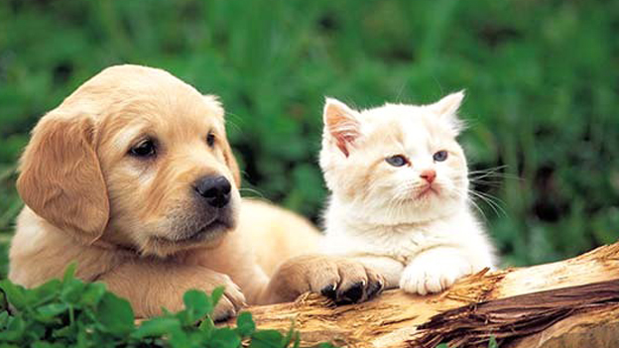
What problem does our website solve??
We are presenting a platform to show our love and care for the lovely creatures who don't have a home, family and words to express themselves. Somewhere they are looking for a home and support from those who understand their feelings.
This Photo by Unknown author is licensed under CC BY-ND.

Slide 3
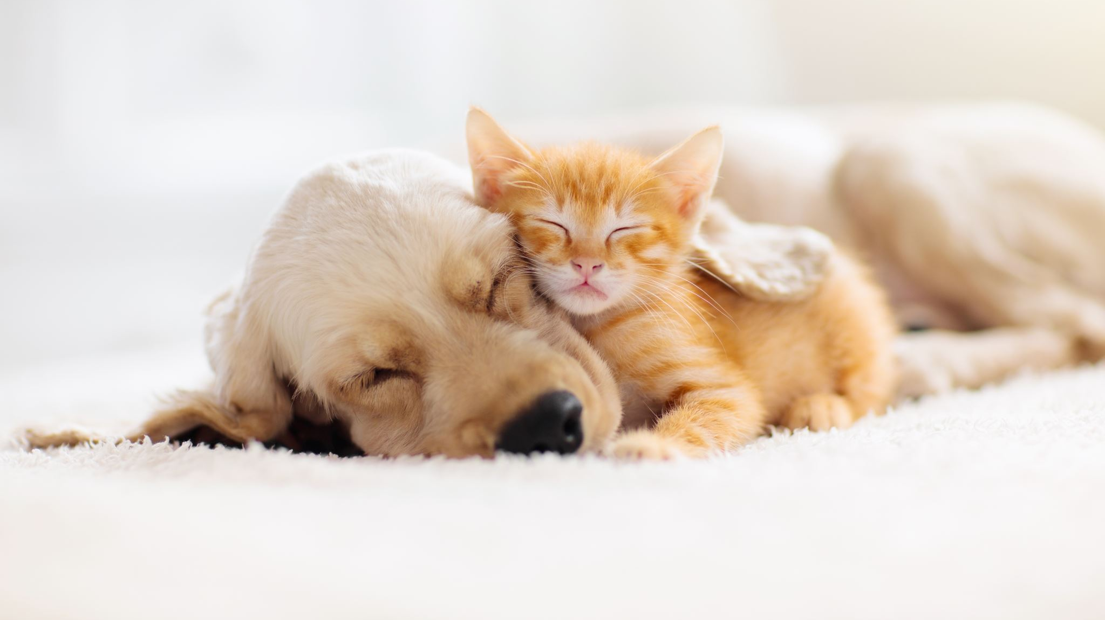
AN INTRODUCTION
This Site includes a lot of features:
Adopt a Pet
PawSpa
Products
Donation

Slide 4
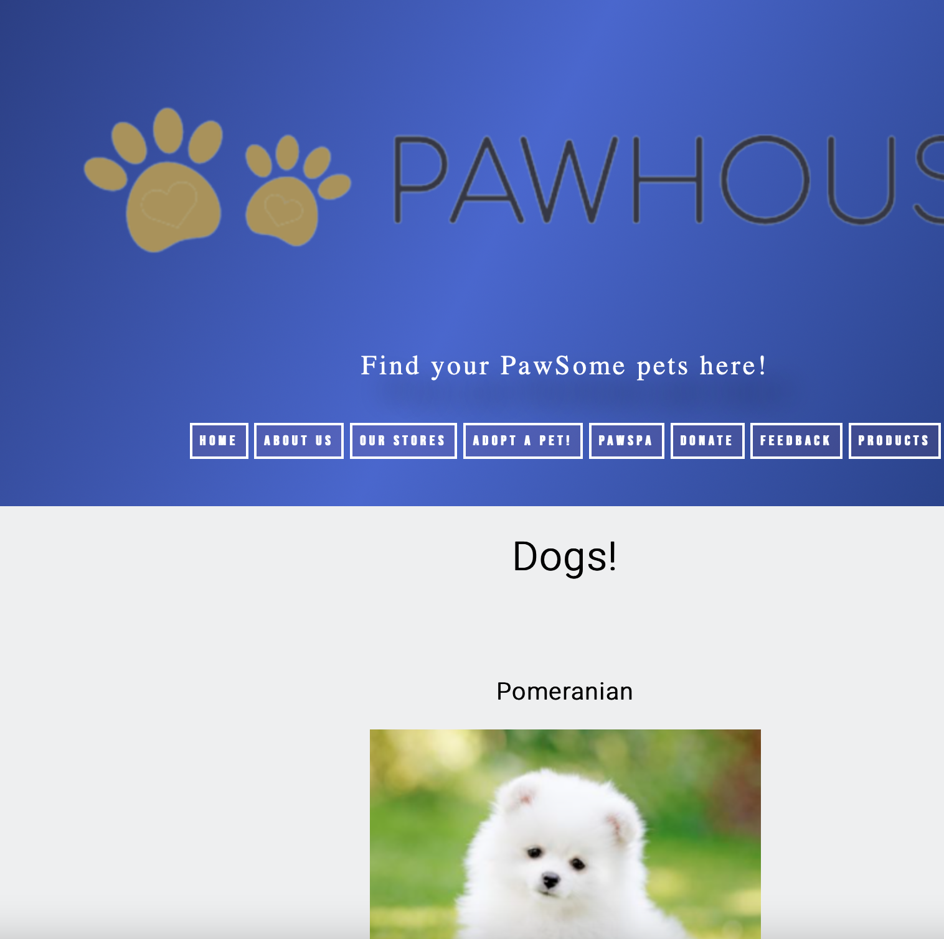
ADOPT A PET
In this feature, you can adopt a pet of your very own! Just choose a pet of your choice by clicking the dropdown list. You can see a preview of the pets and click the link to adopt them!

Slide 5
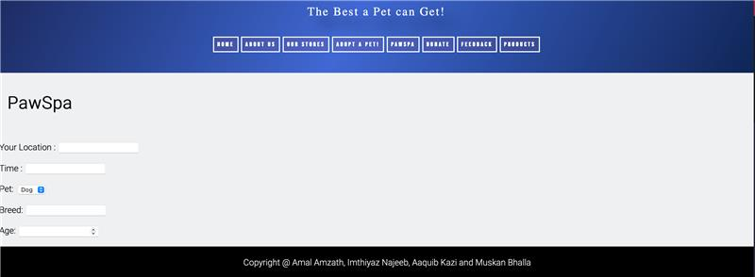
PAWSPA
With this feature, you can turn your shabby-looking pet into a very beautiful-looking one by just entering your location and your breed. Just as you submit, we will be at your doorstep in a few hours.

Slide 6
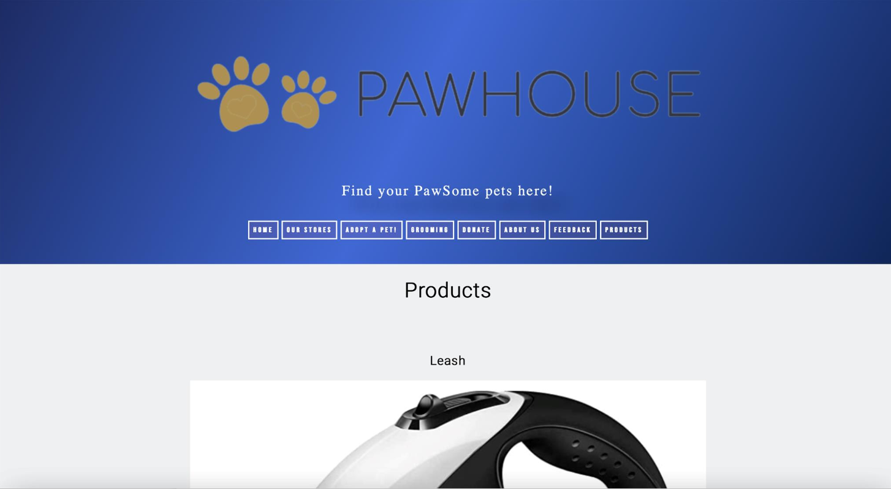

PRODUCTS
By using this feature, you can give your playful companion a toy to play with, so it doesn't get bored. Choose a perfect toy for your furry friend from the variety of products we sell!

Slide 7
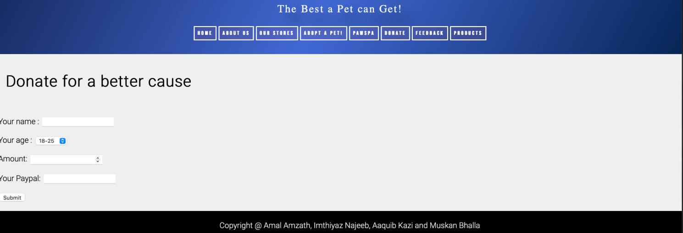
DONATE
You can support our website by donating to us! Just enter the necessary information and you have successfully donated to us! We appreciate you spending your time to support us.

Slide 8
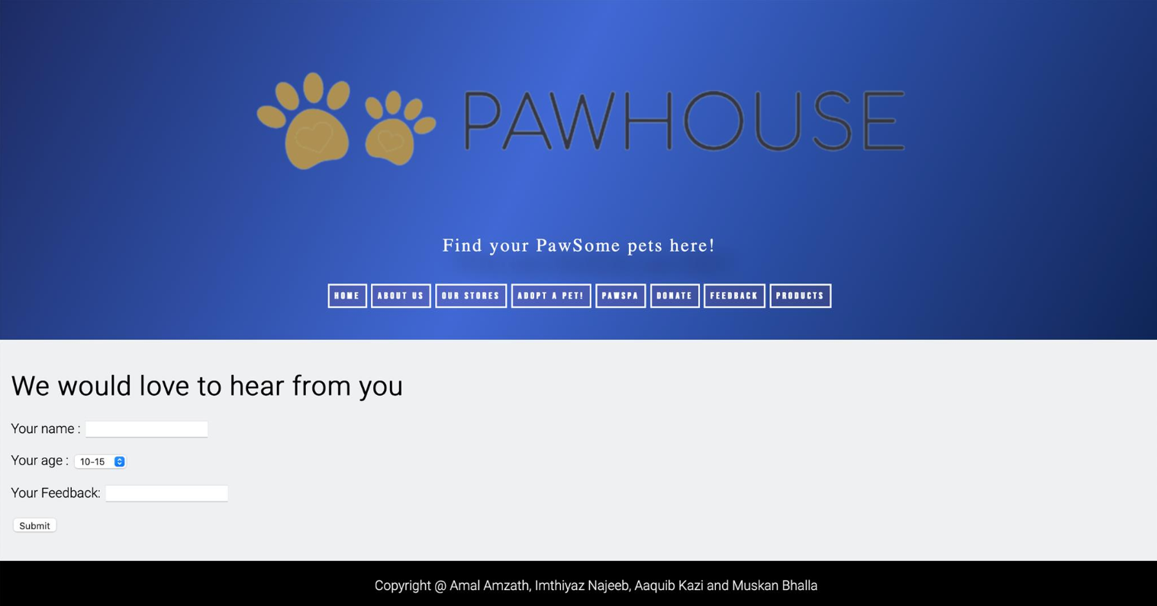
Feedback
By giving your feedback, we will be able to improve our website and make it even better. It will just take a few minutes of your time.

Slide 9
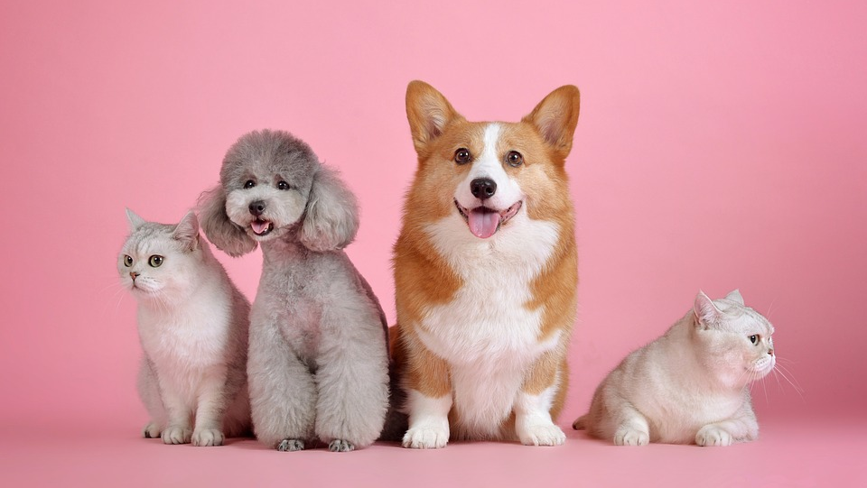
THANK YOU!

